Slide 1






Unit 2 Chapter 2
THINKING LIKE AN ECONOMIST

Slide 2
THE METHOD OF ECONOMICS
Scientific in approach
Objective in nature – formulating a theory, collecting data, and testing the theory
Quantitative and qualitative tools that verify theories
Scientific method of calculating national income
Taxation policies
Financial market and stock prices
Terminologies and their meanings

Slide 3
SCIENTIFIC APPROACH
The interlinkage between theory and observation
For eg: Phillips Curve theory
Economists collect observed data on inflation and unemployment rates
Depending on the correlation, the economist accepts/rejects the theory
Role of assumptions in Economics
Assumption of 2 countries and 2 commodities in trade theory
Assumptions present an idealistic world
Complex and realistic scenarios are added to simple ones
Economic models
Models are simplified representatives of the reality
Using theory, data and assumptions, models are built

Slide 4
SCIENTIFIC APPROACH
The circular flow of income: a visual model of the economy that shows how income flow through markets among households and firms
Firms produce goods and services using the factors of production
Households own and sell the factors of production in order to consume the goods and services
Market for goods and services: households are buyers and firms and sellers
Market for factors: households are sellers and firms are buyers

Slide 5
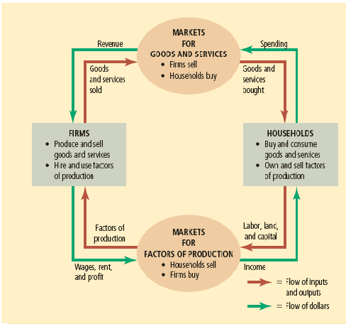
SCIENTIFIC APPROACH
Inner area: the flow of goods, services and factors
Outer area: the flow of income

Slide 6
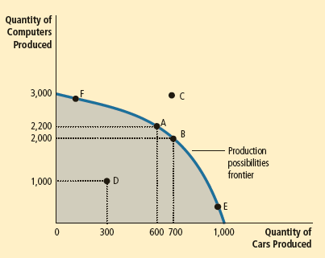
SCIENTIFIC APPROACH
The production possibility frontier (PPF): a graph that shows the combinations of output that the economy can possibly produce given the available factors of production and the available production technology
2900
G
2800

Slide 7
SCIENTIFIC APPROACH
2 commodities assumed
All resources are fully employed
There are efficient, inefficient and not feasible outcomes
Society faces trade-off at efficient outcomes
Opportunity cost of producing one commodity increases with the quantity
There are shifts in PPF due to technological changes

Slide 8
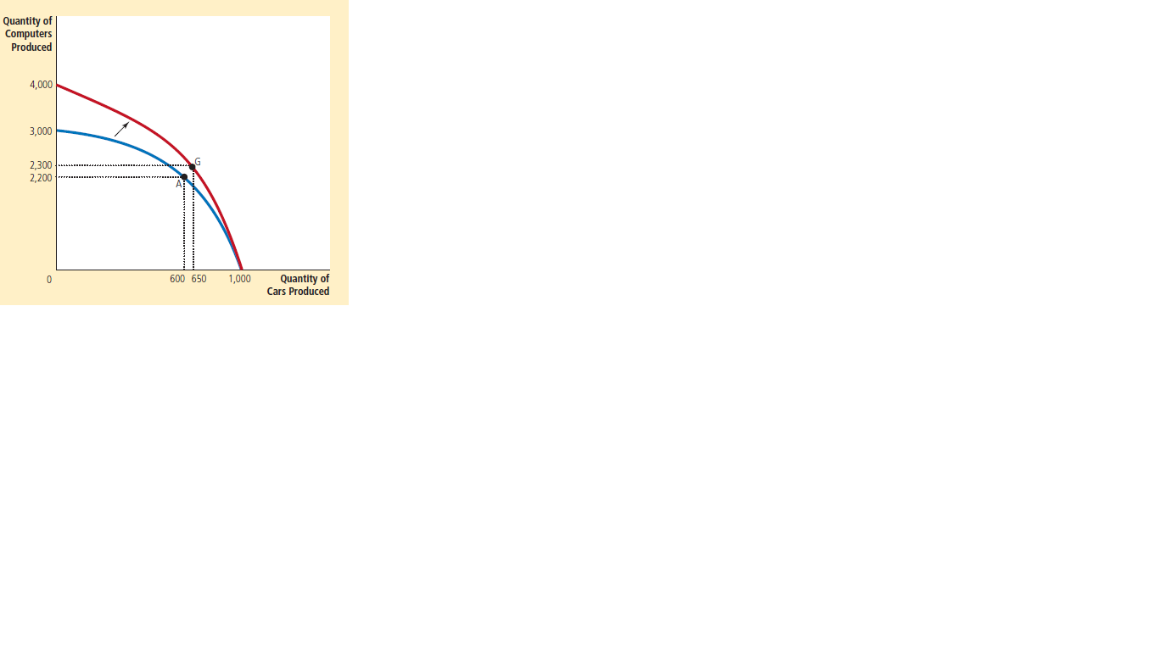
SCIENTIFIC APPROACH
The production possibility frontier (PPF): shifts
They could change the trade-off too

Slide 9
SCIENTIFIC APPROACH
Macroeconomics and Microeconomics
Economics can be studied at the individual level or the economy as a whole
Microeconomics: the study of how households and firms make decisions and how they interact in markets
Macroeconomics: the study of economy-wide phenomena, including inflation, unemployment, and economic growth
Macroeconomic changes are results of individual decision making at the micro-level
Despite interlinks, both are distinct subjects addressing different questions

Slide 10
ECONOMIST AS POLICY ADVISOR
Often encounter undesirable economic outcomes and related policy suggestions
Positive v/s Normative economics
Positive: explain what is observed or what the world is
Normative: explain how the world should be
Economics is largely positive with normative goals to attain
Current situation v/s future considerations
Not all economic policies are implemented by the leaders
Concerns arise between economy and political administration

Slide 11
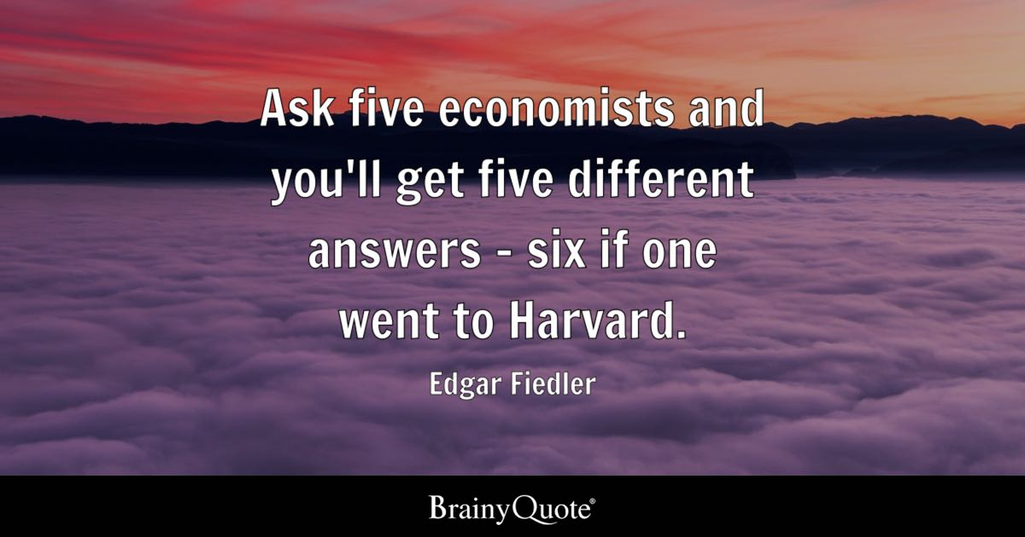
WHY ECONOMISTS DISAGREE

Slide 12
WHY ECONOMISTS DISAGREE
Differences in scientific judgements
Based on the previous experience
Based on the school of thought
Differences in normative values
Based on fair actions
Based on differing value judgements
Perception v/s reality
What is the optimal and what is the real

